Slide 1

Agile and Scrum
Course Introduction

Slide 2
About the Course
One day overview of Agile processes and the Scrum framework
General applications of Agile concepts
  Not just software development
Integration with related concepts and methods
  Lean processes
  Design thinking
  The innovation dilemma
Class discussion on how to apply in your environment

Slide 3
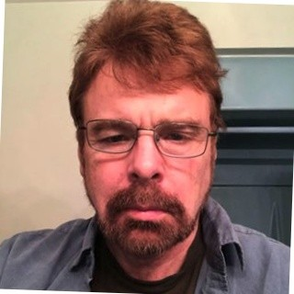
Instructor – Rod Davison
50 years experience
  Academia (math, linguistics, cognitive science)
  Artificial Intelligence R&D
  Software Development
  Data Analytics – Social Research
  Market Research
  Project Manager
  Research Director
  Quality and Testing
  Business Analysis
  Consulting and Training

Slide 4

Introduce Yourself
Briefly, share with us your:
  Name you prefer to use in class
  Area of professional expertise
  Current job responsibility if relevant
  Related experience or training
  Goals for the course
Also…
  Please ask any questions you might have about the class

Slide 5
Logistics
Review of class hours and breaks
  Oct 19-20: 8 am to 4 pm EST
  Lunch is fixed at 12-1 EST to ensure you have a known time to plan calls, meetings, etc
  10 min breaks mid-morning-ish and mid-afternoon-ish

Slide 6
Class Materials
All class materials are available at:
  https://github.com/ExgnosisClasses/Agile-Scrum-Dec15
  This repo will be available until Jan 15, 2024
All materials in the repos are either:
  Written by the instructor under a creative commons license
  Provided by third parties with licenses that allow sharing

Slide 7
End of Module

